Slide 1

CSE 491:CLOUD COMPUTING
Virtualization and Cloud Computing
Jannatun Noor
Lecturer,
BRAC University
Jannatun.noor@bracu.ac.bd

Slide 2
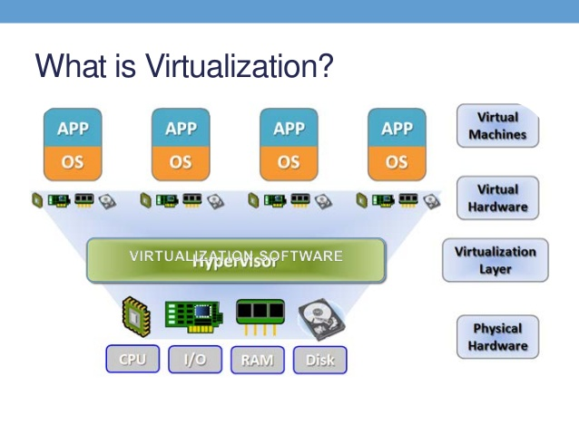
Virtualization is the ability to run multiple operating systems on a single physical system and share the underlying hardware resources*
*VMWare white paper, Virtualization Overview

Slide 3
It is the process by which one computer hosts the appearance of many computers.

Slide 4
Virtualization is used to improve IT throughput and costs by using physical resources as a pool from which virtual resources can be allocated.

Slide 5
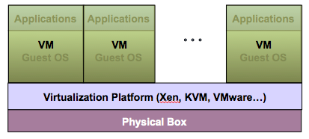
Virtualization Architecture
A Virtual machine (VM) is an isolated runtime environment (guest OS and applications)
Multiple virtual systems (VMs) can run on a single physical system

Slide 6
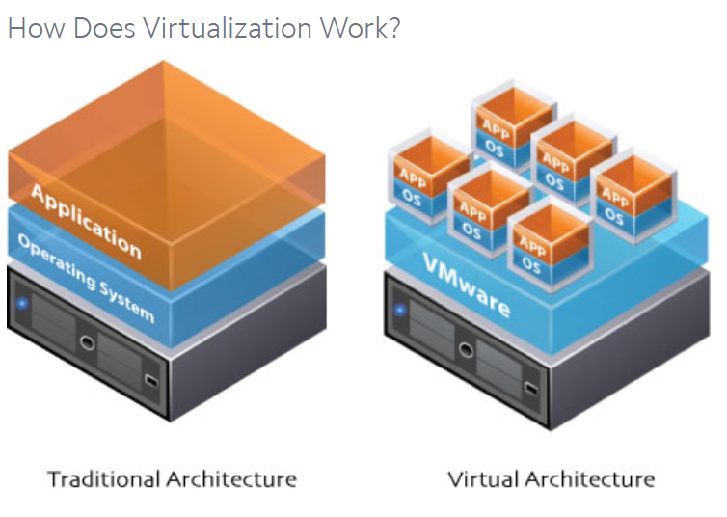
Notes:
Virtualization relies on software to simulate hardware functionality and create a virtual computer system. This enables IT organizations to run more than one virtual system – and multiple operating systems and applications – on a single server. The resulting benefits include economies of scale and greater efficiency.

Slide 7
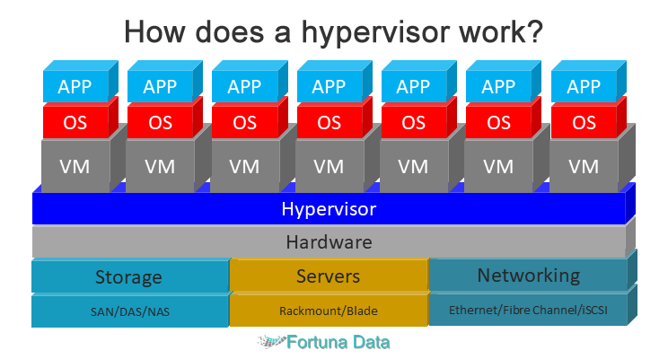
A hypervisor, a.k.a. a virtual machine manager/monitor (VMM), or virtualization manager, is a program that allows multiple operating systems to share a single hardware host.
Notes:
Image link

Slide 8
Each guest operating system appears to have the host's processor, memory, and other resources all to itself. However, the hypervisor is actually controlling the host processor and resources, allocating what is needed to each operating system in turn and making sure that the guest operating systems (called virtual machines) cannot disrupt each other.
Notes:
Image link

Slide 9
Benefits of Virtualization
Sharing of resources helps cost reduction
Isolation: Virtual machines are isolated from each other as if they are physically separated
Encapsulation: Virtual machines encapsulate a complete computing environment
Hardware Independence: Virtual machines run independently of underlying hardware
Portability: Virtual machines can be migrated between different hosts.

Slide 10
Virtualization in Cloud Computing
Cloud computing takes virtualization one step further:
You don’t need to own the hardware
Resources are rented as needed from a cloud
Various providers allow creating virtual servers:
Choose the OS and software each instance will have
The chosen OS will run on a large server farm
Can instantiate more virtual servers or shut down existing ones within minutes
You get billed only for what you used

Slide 11
Components of Virtual Machines?
Configuration file
Virtual machine configuration is the arrangement of resources assigned to a virtual machine. The resources allocated to a virtual machine (VM) typically include allocated processors, memory, disks, network adapters and the user interface.
The file responsible for holding the configuration of a particular VM is <vmHostName>. vmx. This is the primary configuration file, which stores settings chosen in the New Virtual Machine Wizard or virtual machine settings editor.
Notes:
Virtual machine configuration is the arrangement of resources assigned to a virtual machine. The resources allocated to a virtual machine (VM) typically include allocated processors, memory, disks, network adapters and the user interface.
The file responsible for holding the configuration of a particular VM is <vmHostName>. vmx. This is the primary configuration file, which stores settings chosen in the New Virtual Machine Wizard or virtual machine settings editor.
This is the file that stores the state of the virtual machine's BIOS. This is a virtual disk file, which stores the contents of the virtual machine's hard disk drive.
The virtual machine paging file, which backs up the guest main memory on the host file system. This file exists only when the virtual machine is running or if the virtual machine fails. It is stored in the working directory. Each snapshot of a virtual machine that is powered on has an associated

Slide 12
Components of Virtual Machines?
Hard disk file(s)
This is a virtual disk file, which stores the contents of the virtual machine's hard disk drive.
Virtual machine state file
This is the file that stores the state of the virtual machine's BIOS
Notes:
Virtual machine configuration is the arrangement of resources assigned to a virtual machine. The resources allocated to a virtual machine (VM) typically include allocated processors, memory, disks, network adapters and the user interface.
The file responsible for holding the configuration of a particular VM is <vmHostName>. vmx. This is the primary configuration file, which stores settings chosen in the New Virtual Machine Wizard or virtual machine settings editor.
This is the file that stores the state of the virtual machine's BIOS. This is a virtual disk file, which stores the contents of the virtual machine's hard disk drive.
The virtual machine paging file, which backs up the guest main memory on the host file system. This file exists only when the virtual machine is running or if the virtual machine fails. It is stored in the working directory. Each snapshot of a virtual machine that is powered on has an associated

Slide 13
Components of Virtual Machines?
In-memory file
The virtual machine paging file, which backs up the guest main memory on the host file system. This file exists only when the virtual machine is running or if the virtual machine fails. It is stored in the working directory. Each snapshot of a virtual machine that is powered on has an associated
Notes:
Virtual machine configuration is the arrangement of resources assigned to a virtual machine. The resources allocated to a virtual machine (VM) typically include allocated processors, memory, disks, network adapters and the user interface.
The file responsible for holding the configuration of a particular VM is <vmHostName>. vmx. This is the primary configuration file, which stores settings chosen in the New Virtual Machine Wizard or virtual machine settings editor.
This is the file that stores the state of the virtual machine's BIOS. This is a virtual disk file, which stores the contents of the virtual machine's hard disk drive.
The virtual machine paging file, which backs up the guest main memory on the host file system. This file exists only when the virtual machine is running or if the virtual machine fails. It is stored in the working directory. Each snapshot of a virtual machine that is powered on has an associated

Slide 14
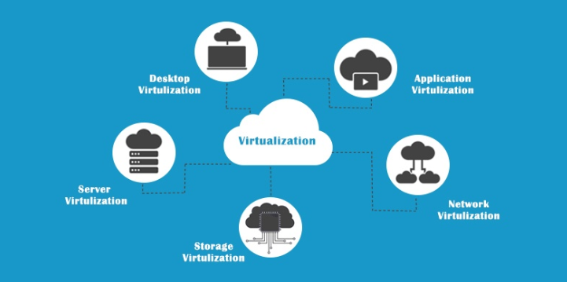
Virtualization Types
Desktop Virtualization
Server Virtualization
Network Virtualization
Storage Virtualization
Application Virtualization
Notes:
‹#›

Slide 15
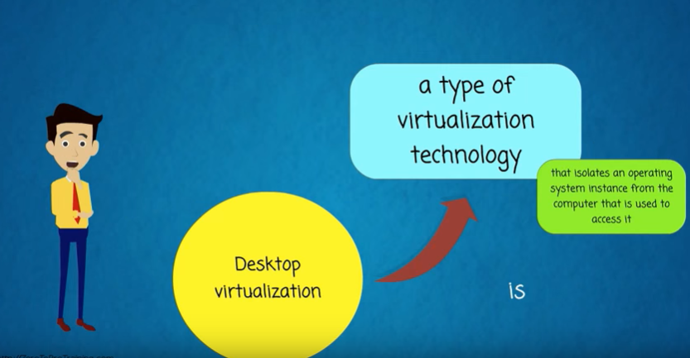
Desktop Virtualization

Slide 16
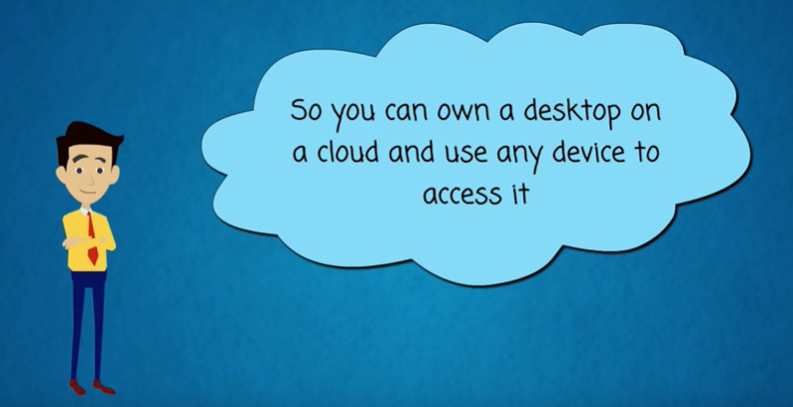
Desktop Virtualization

Slide 17
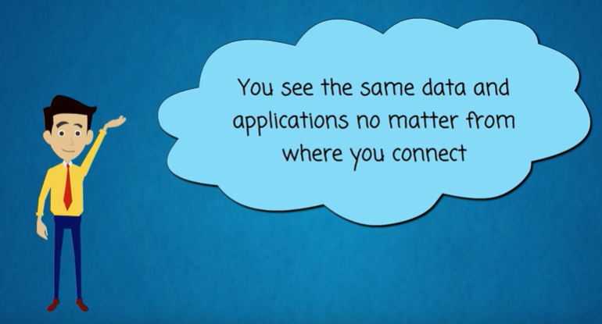
Desktop Virtualization

Slide 18
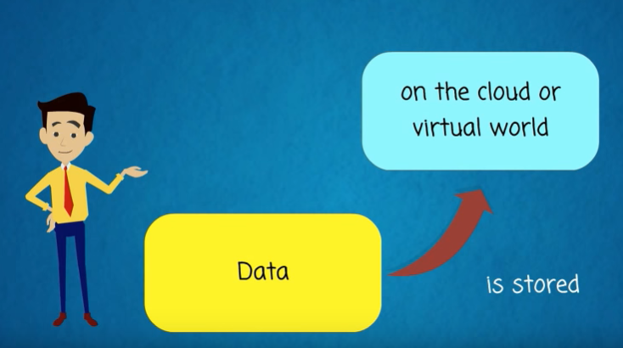
Desktop Virtualization

Slide 19
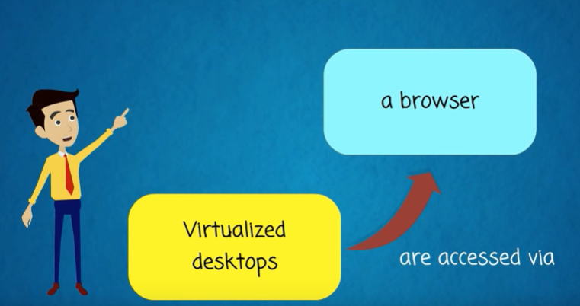
Desktop Virtualization

Slide 20
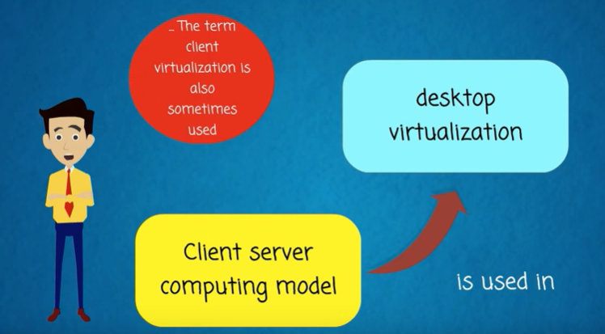
Desktop Virtualization

Slide 21
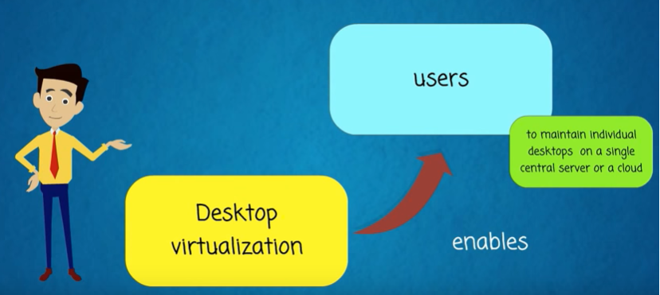
Desktop Virtualization

Slide 22
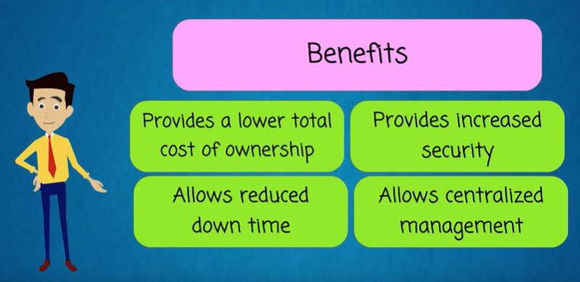
Desktop Virtualization

Slide 23
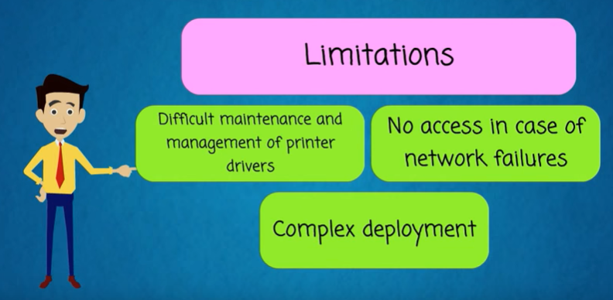
Desktop Virtualization

Slide 24
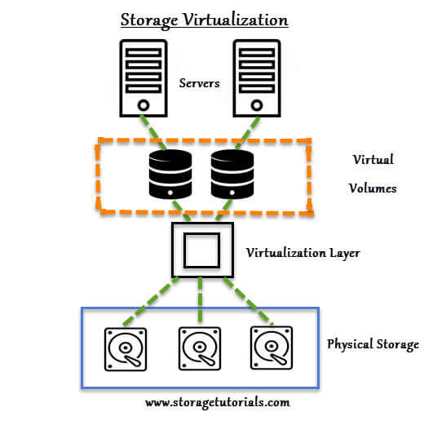
Storage Virtualization
Multiple physical storage devices are grouped together, which then appear as a single storage device.
This provides various advantages such as homogenization of storage across storage devices of multiple capacity and speeds, reduced downtime, load balancing and better optimization of performance and speed.

Slide 25
Storage Virtualization
Partitioning your hard drive into multiple partitions is an example of this virtualization.
Subtype:
Block Virtualization – Multiple storage devices are consolidated into one
File Virtualization – Storage system grants access to files that are stored over multiple hosts

Slide 26
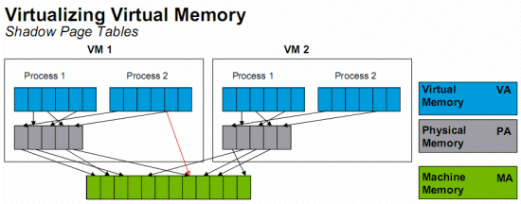
Memory Virtualization
Physical memory across different servers is aggregated into a single virtualized memory pool.
It provides the benefit of an enlarged contiguous working memory.
You may already be familiar with this, as some OS such as Microsoft Windows OS allows a portion of your storage disk to serve as an extension of your RAM.

Slide 27
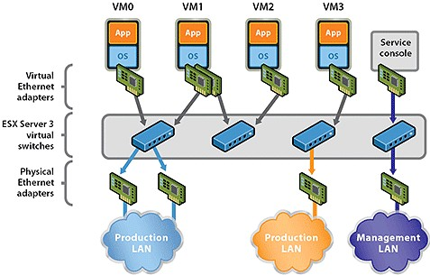
Network Virtualization
Multiple sub-networks can be created on the same physical network, which may or may not is authorized to communicate with each other.

Slide 28
Network Virtualization
This enables restriction of file movement across networks and enhances security, and allows better monitoring and identification of data usage which lets the network administrator’s scale up the network appropriately.

Slide 29
Network Virtualization
It also increases reliability as a disruption in one network doesn’t affect other networks, and the diagnosis is easier.

Slide 30
Server Virtualization
Software (SoftV)
Hardware (HardV)

Slide 31
Software Virtualization
Software Virtualization involves the creation of an operation of multiple virtual environments on the host machine.
It creates a computer system complete with hardware that lets the guest operating system to run.
For example, it lets you run Android OS on a host machine natively using a Microsoft Windows OS, utilizing the same hardware as the host machine does.

Slide 32
Software Virtualization
Subtypes:
Operating System Virtualization – hosting multiple OS on the native OS
Application Virtualization – hosting individual applications in a virtual environment separate from the native OS
Service Virtualization – hosting specific processes and services related to a particular application

Slide 33
SoftV Server Virtualization Architecture
Applications
Applications
Applications
V i r t u a l
Guest OS (Windows)
Guest OS (Linux)
Guest OS (VMware ESX)
Virtual Machine
Virtual Machine
Virtual Machine
Virtual Machine Manager(Server Products)
P h y s i c a l
Host OS(Server Products)
Hardware

Slide 34
Hardware Virtualization
Hardware virtualization also known as hardware-assisted virtualization or server virtualization runs on the concept that an individual independent segment of hardware or a physical server, may be made up of multiple smaller hardware segments or servers, essentially consolidating multiple physical servers into virtual servers that run on a single primary physical server.
The main advantages include increased processing power as a result of maximized hardware utilization and application uptime.
Each small server can host a virtual machine, but the entire cluster of servers is treated as a single device by any process requesting the hardware.
The hardware resource allotment is done by the hypervisor.

Slide 35
HardV Server Virtualization Architecture
Applications
Applications
V i r t u a l
Guest OS (Windows)
Guest OS (Linux)
Virtual Machine
Virtual Machine
Host OS
Virtualization Layer
P h y s i c a l
Hardware

Slide 36
HardV Server Virtualization Architecture
Applications
Applications
Applications
Guest OS (Windows)
Guest OS (Linux)
Guest OS (VMware ESX)
V i r t u a l
Virtual Machine
Virtual Machine
Virtual Machine
Host OS + Virtualization Layer
P h y s i c a l
Hardware

Slide 37
HardV Server Virtualization Architecture
Applications
Applications
Applications
Guest OS (Windows)
Guest OS (Linux)
Guest OS (VMware ESX)
V i r t u a l
Virtual Machine
Virtual Machine
Virtual Machine
Virtualization Layer (Hypervisor)
P h y s i c a l
Hardware

Slide 38
References
Virtualization: https://youtu.be/l0DfHUWMjsU
Desktop: https://www.youtube.com/watch?v=WpRxOAs5mpY
https://www.redswitches.com/blog/different-types-virtualization-cloud-computing-explained/
Storage: https://youtu.be/5cYwcM8WQss
Memory: https://youtu.be/cZNUve70dmY
Network: https://youtu.be/5xTx6qQ-kfo
https://youtu.be/HFQdbOY8Ams
Server: https://youtu.be/p11lJOnALS4
https://youtu.be/jHcvNxGfqfs

